Slide 1

Looking after your baby’s teeth

Slide 2
Programme
Teething
Brushing your child’s teeth
What is tooth decay and causes of tooth decay
Tips for preventing tooth decay
Visiting the Dentist
Healthy foods, snacks and drinks
Dummies, bottles and cups

Slide 3
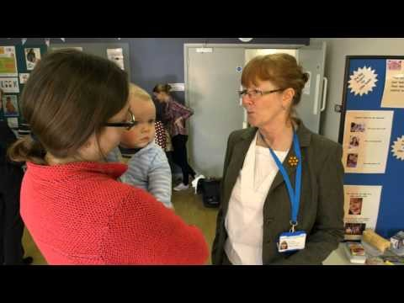
Kind permission for use from the
GWH NHS Foundation Trust oral health promotion team

Slide 4
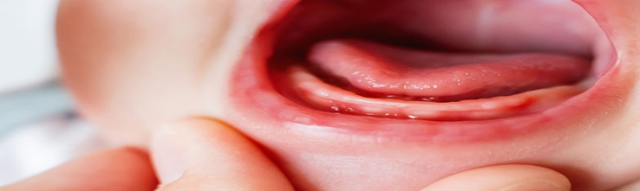
Teething
Most babies start teething around 6 months, some babies might start before that or after. Most Children will have all their milk teeth by two and a half.
Teething symptoms:
Your baby's gum is sore and red where the tooth is coming through.
One cheek is flushed.
They are rubbing their ears.
Your baby is dribbling more than usual can leave a rash on their chin.
They are chewing on things a lot.
They are more fretful than usual.

Slide 5
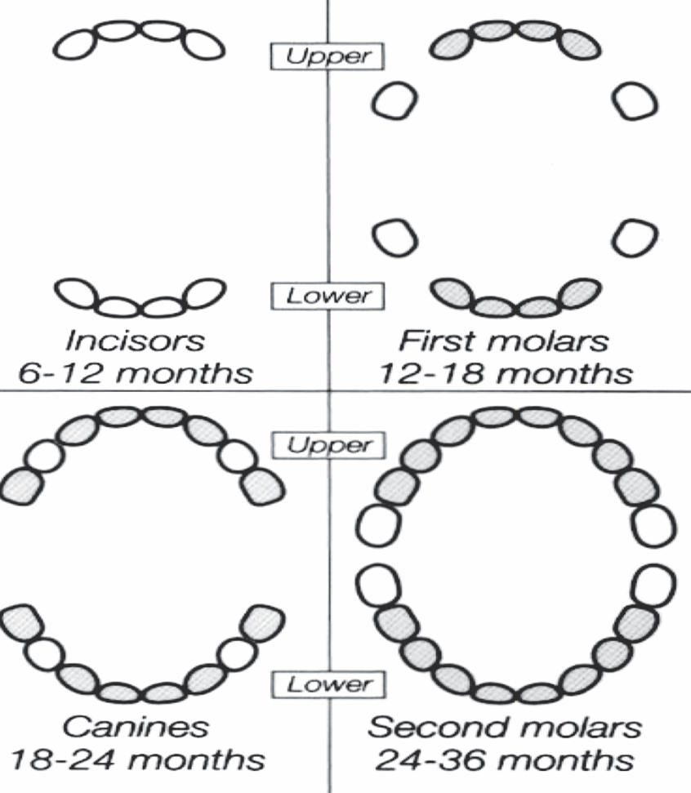
Tooth eruption chart

Slide 6
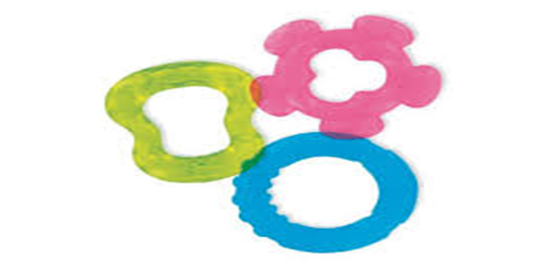
Ways to ease teething pains
Teething rings to chew on this may ease their discomfort and distract them from any pain. Some teething rings can be cooled first in the fridge, never put them in the freezer as it could damage their gums.
If your baby is 6 months or older, you can give them healthy things to chew on, such as raw fruit, vegetables or breadsticks.
Teething gels for children and sugar free medicine.

Slide 7
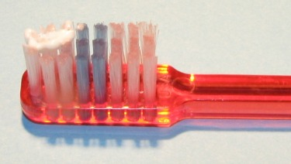
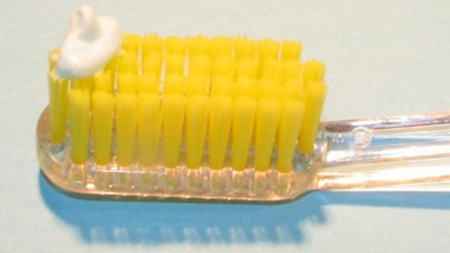
Brushing your child’s teeth
When to start and what to use:
Start brushing your baby’s teeth as soon as they come through.
Use toothbrushes suited for their age (can use finger toothbrushes for baby’s first teeth).
Use a tiny smear of toothpaste for children aged 0-3.
Use a pea sized amount of toothpaste for children aged 3-6.
It is advised to use toothpaste with a fluoride level of 1000ppm.

Slide 8
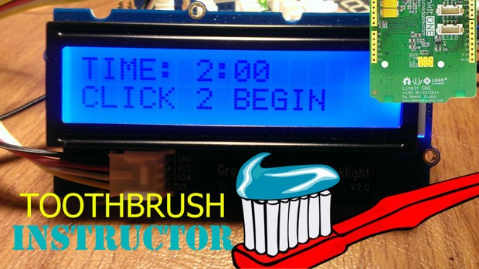
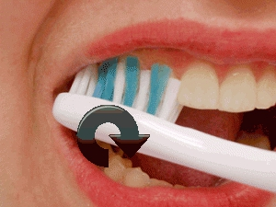
How to brush your child’s teeth:
Brush teeth twice daily, just before bed and another time in the day that fits with your routine.
Carers or parents should brush or supervise tooth brushing.
It is advised to brush the teeth for 2 minutes.
Easiest way to brush baby’s teeth is to sit them on your knee, tilt their head back so it is resting on your chest.
With an older child stand behind them and tilt their head backwards.
Brush the teeth in small circles, covering all the surfaces.
Encourage child to spit the toothpaste out afterwards, there is no need to rinse with water.
Your children need help brushing their teeth until they are at least 7 years old.

Slide 9
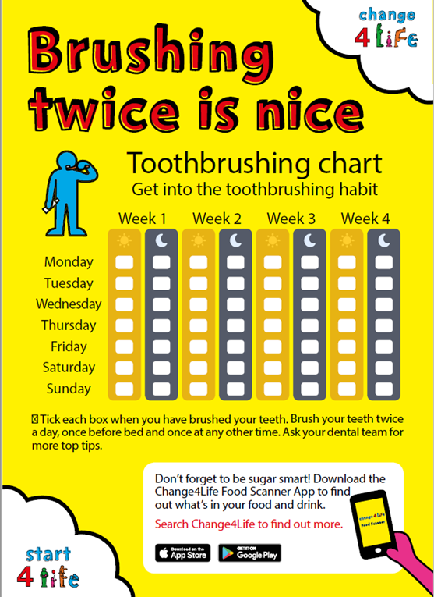
Top tips for tooth brushing:
Don’t worry if you don’t manage to brush much at first the important thing is to get your baby used to their new routine.
Make it into a game, sing songs i.e. “Hey Duggee- The tooth brushing song” or “Brush your teeth” in the melody of baby shark.
Set an example and brush your own teeth at the same time so they can copy you (this can work from a young age).
Change 4 life tooth brushing chart.

Slide 10
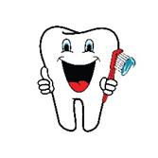
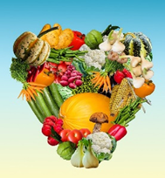
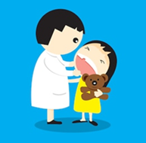
What is tooth Decay?
Plaque and acid attacks can lead to tooth decay
Tooth decay is something we all want to prevent as parents, as it can cause pain and discomfort, disturbed sleep, eating difficulties and behavioural issues.
There are 500 hospital admissions a year in Wiltshire for children 5 and under to have decayed teeth removed.
The good news is that tooth decay is largely preventable by parents doing three important things:
brushing your baby and child’s teeth twice a day with fluoride toothpaste
being careful about sugar in your baby and child’s food and drinks
visiting the Dentist when the first tooth appears and then regularly

Slide 11
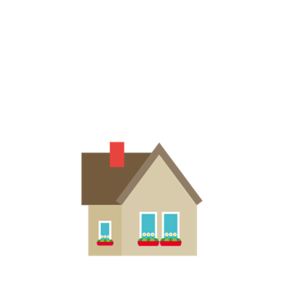
Visiting the Dentist
NHS Dental treatment is free for children.
Women are entitled to free NHS dental treatment during pregnancy and any treatment commenced before their baby’s 1st birthday.
Take your baby to the dentist as soon as their teeth start to appear and visit regularly, as often as your dentist recommends.
Ask your dentist about Fluoride varnish – all children over 3 should have this applied to their teeth.

Slide 12
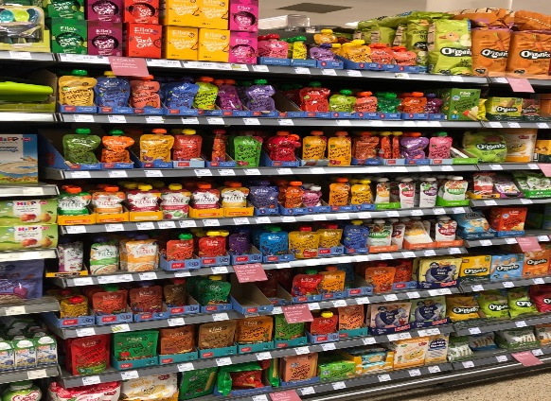
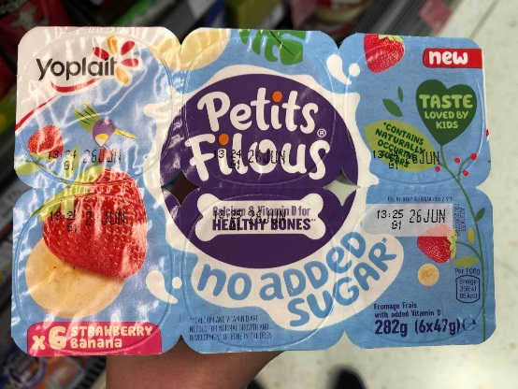
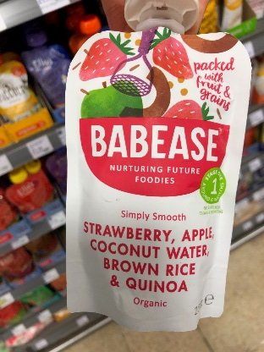
Healthy foods
Top Tips for feeding your baby:
Breastfeeding provides all the nutrition your baby needs for the first 6 months or a First Infant Formula.
As you introduce solid foods from 6 months, only offer breast or formula milk and water between meals.
To be careful about sugar in foods look at food labels on baby food.
The sugars found naturally in whole fruit and milk are less likely to cause tooth decay, so you don't need to cut down on these types of sugars.
Introducing solid foods e-group available see out website or speak to our SPA on 03002470090

Slide 13

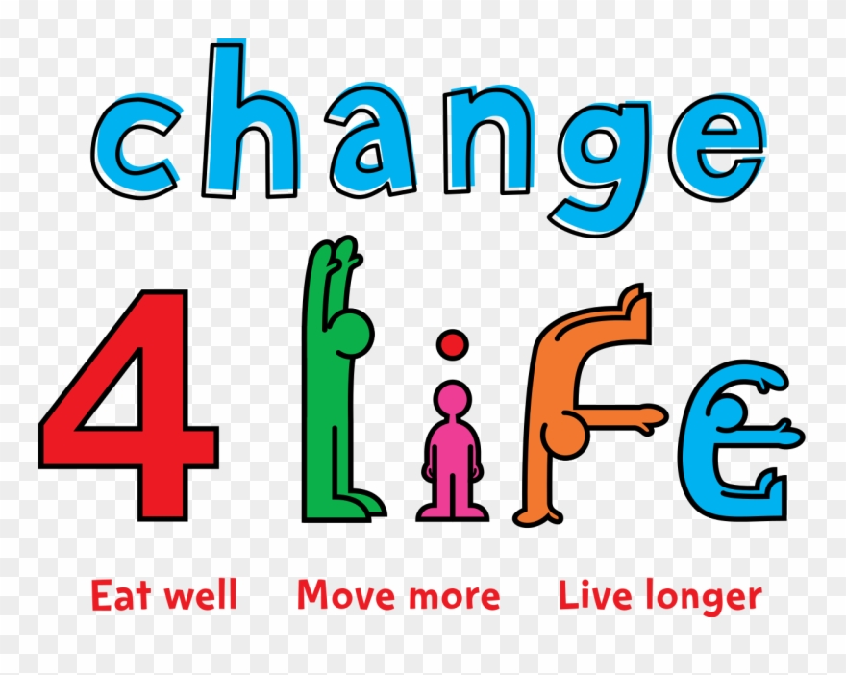
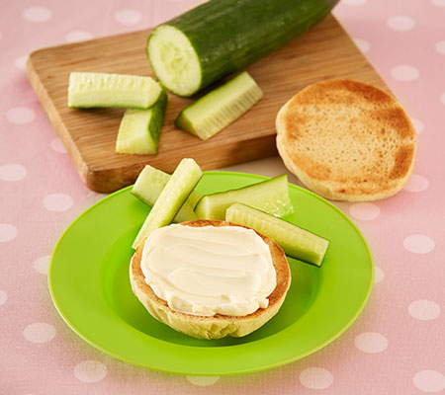
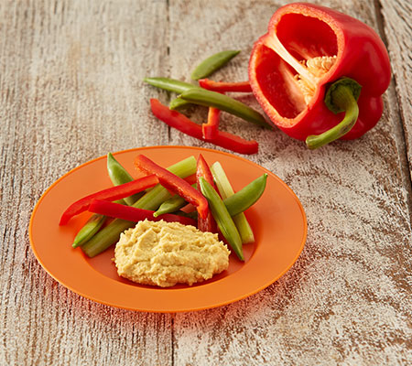
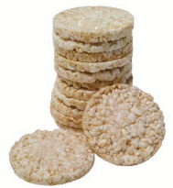
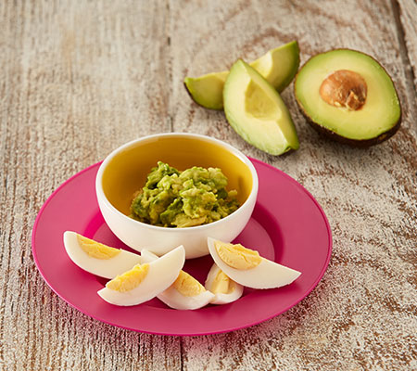
Tooth-friendly ideas for snacks from 12 Months onwards
There are lots of great ideas on the and First Steps Nutrition websites.
Savoury foods such as cheese, pasta and vegetables are better than sweet foods. Food that doesn't contain sugar is better for your baby's teeth.
Dried fruit can stick to the teeth so it’s better to consume it as part of a meal and not as a between-meal snack.

Slide 14
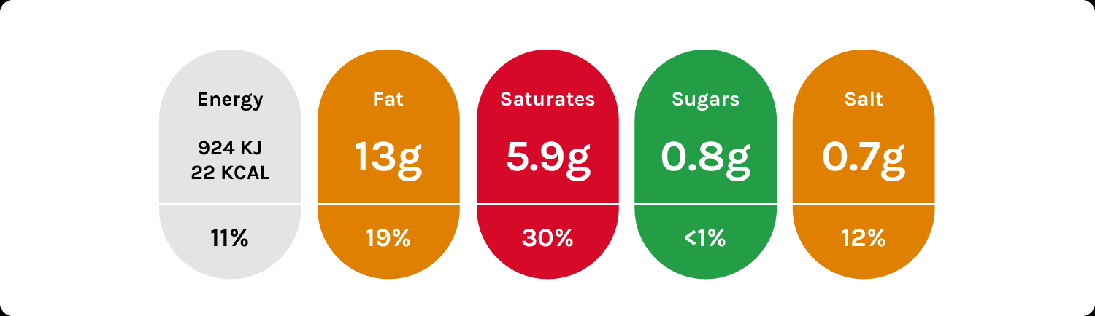
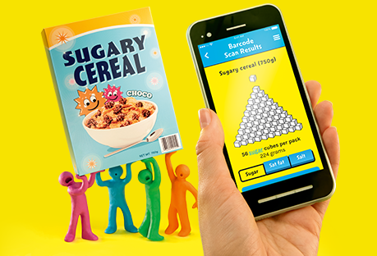
Added sugar
High: more than 22.5g of total sugars per 100g
Low: 5g of total sugars or less per 100g
Some foods have labels on them with a traffic light system.
When you're choosing between similar products, try to go for more greens and ambers, and fewer reds, if you want to make a healthier choice.
But remember, even healthier ready baby meals may be higher sugar than the homemade equivalent.
And if you make the meal yourself, you could also save money.

Slide 15
Bottles, Cups and Dummies
Once your child is 1 year old, drinking from a bottle should be discouraged, introduce your baby to drinking from a beaker from around 6 months.
Teats encourage children to suck for long periods of time, meaning the drinks that cause tooth decay stay in contact with your child's teeth for a long time.
A beaker with a free-flow lid (without a non-spill valve) is better than a bottle or beaker with a teat as it will help your baby to learn how to sip rather than suck which is better for their teeth.
As soon as your child is ready, encourage them to move from a lidded beaker to drinking from an open cup.

Slide 16
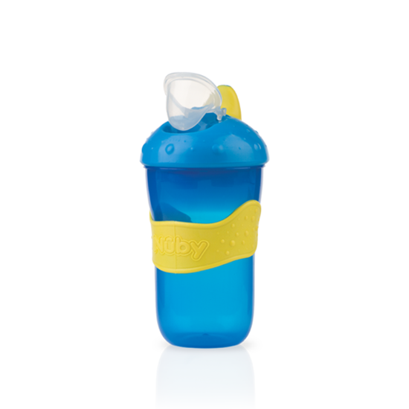
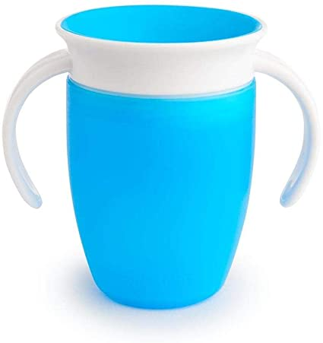
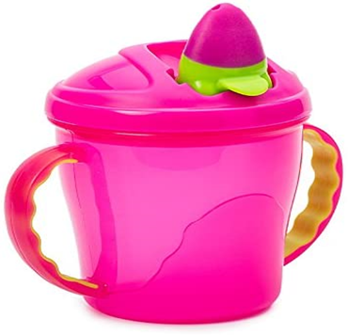
Examples of free flow beakers

Slide 17
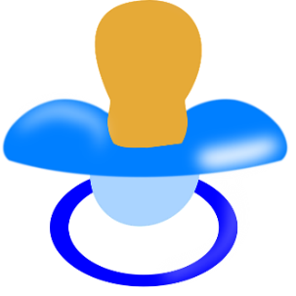
Dummies
Try to use a dummy for short periods of time and discourage continual sucking. Do not dip a dummy in sweet foods and drinks, such as syrups, jams or fruit juice as this can cause tooth decay.
Your child should stop having a dummy or reduce the amount of time they have it by the age of 1.
The Main reasons for this are:
Continual use of a dummy in a child's mouth may prevent them from making speech sounds and tongue movements.
Teeth may become pushed out of place and affect the alignment of them due to long term use of a dummy.

Slide 18
Final Message
The good news is that tooth decay is largely preventable.
The three important measures are:
Brush your baby and toddler’s teeth at bedtime and one other time a day with fluoride toothpaste.
Reduce the amount of sugar in meals, snacks and drinks.
Visit the Dentist when baby’s first tooth appears and regularly afterwards.

Slide 19
Useful Links
https://www.nhs.uk/conditions/pregnancy-and-baby/looking-after-your-infants-teeth/
https://www.nhs.uk/live-well/healthy-body/taking-care-of-childrens-teeth/
https://www.nhs.uk/start4life/
https://www.nhs.uk/change4life/food-facts/sugar/sugar-swaps-for-kids
www.firststepsnutrition.org
To find an NHS dentist visit NHS Choices: www.nhs.uk/NHSEngland/AboutNHSservices/dentists/Pages/find-an-NHS-dentist.aspx
Call our SPA for advice on: 0300 2470090

